Slide 1
Course Registration Final Project
Justin Villanueva
The University of Arizona Global Campus
CST 499: Capstone for Computer Software Technology
Dr. Charmelia Butler
July 22, 2024

Slide 2

Software Requirements Specifications (SRS) Document
Overall Description
External Interface Requirements
System Features
Student Management
Course Registration
Notes:
“SRS is a kind of agreement between the customer and the company, which contains complete information about the requirements desired by the customer and the product made by the company” (GeeksforGeeks, 2024). Overall, this system is a course registration website that features individual student accounts, capabilities to enroll and disenroll in available courses, and be added to the waitlist of unavailable courses.
This system will utilize HTML, PHP, and MySQL. It should be able to operate on personal computers and mobiles devices through mobile applications and web browsers including Chrome, Edge, Firefox, and Safari. Functional requirements are centered around the Student Management and Course Registration systems.
The Student Management system should be able to register new and store existing student credentials to a database that will be referenced for logging into the system and performing the course registration functionalities.
The Course Registration system will require databases for the courses available, student course enrollments, and course waitlists. Users should be able to add and delete courses to and from their schedule and waitlists. It will also feature a waitlist notification functionality that notifies the next student on the waitlist of availability and provide the option to enroll in the previously unavailable course.

Slide 3

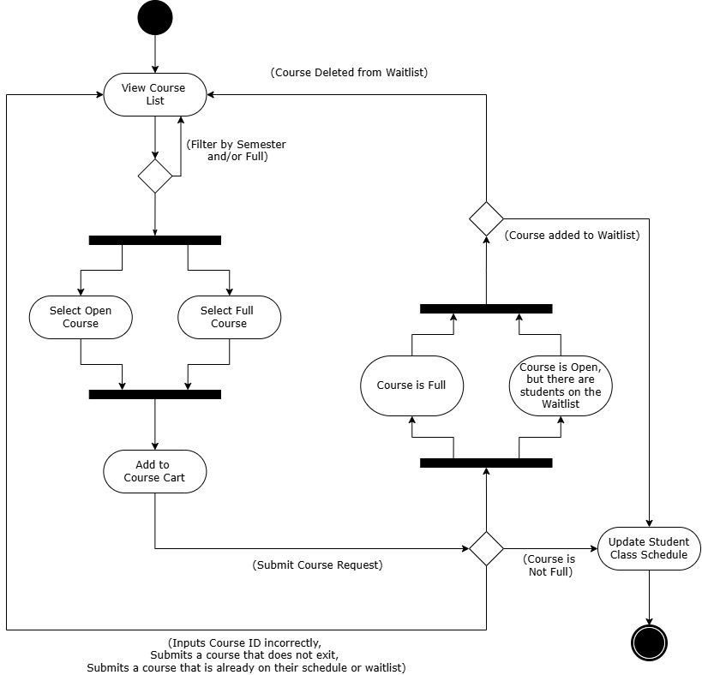
Unified Modeling Language (UML) Design Model – Activity Model
Notes:
“Unified Modeling Language (UML) is a standardized visual modeling language used in the field of software engineering to provide a general-purpose, developmental, and intuitive way to visualize…the behavior and structure of a system” (GeeksforGeeks, 2024).
First, we have an activity model depicting how a student would go through the process of registering for a course. They will start with looking through the course list on the course catalog to view open and full courses that the university offers. Once they decide on a course, they will select the course by inputting the course ID to the registration text box.
If the user made a mistake with the spelling of the course ID, inputted a class they are already enrolled into or waitlisted for, or put in a course that isn’t currently offered in the university, they will be sent back to the course list to choose another course to select. If the course is full or is showing available, but there are currently students on the waitlist, students attempting to enroll in this class will be automatically added to the waitlist. They can later delete themselves from that waitlist if desired. Finally, if the course is available at the time of enrollment, it will be successfully added to their schedule.

Slide 4
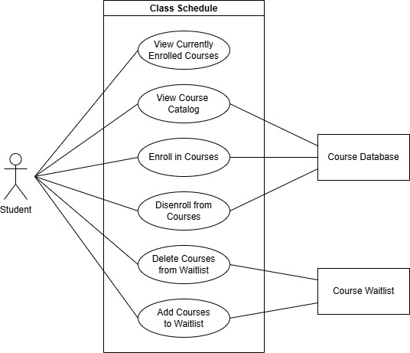
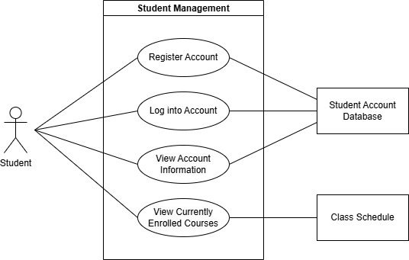
Unified Modeling Language (UML) Design Model- Use Case Models
Notes:
Here are two use case models for the class schedule and student management. As stated previously, the student use the class schedule to perform the activities outlined in the activity model. These use cases either interact with the course database or waitlist database. A user interacting with the student management system will be able to register a new account, log into an existing account, view their account information, and view their currently enrolled courses and waitlists. Everything will be interacting with the student account database other than the course enrollments and waitlists, which interacts with the class schedule system.

Slide 5
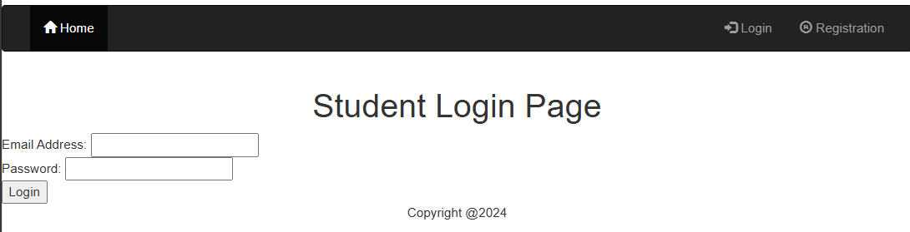
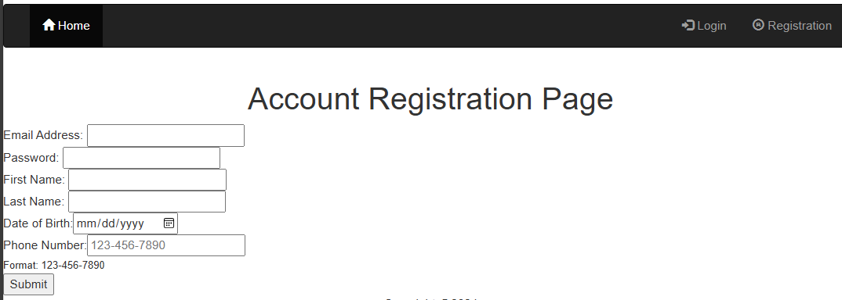
Landing, Login, and
Registration Pages
Notes:
When using this website, the landing page is where users will first be introduced to the system where there are options to either log into an existing account or register a new account. All fields in these two forms shown are given the required constraint. If any of the fields are left blank when submitting the information, it will indicate which fields need to be filled in. The account registration form also features the date and telephone types to have a standardized format for registration. If either field is entered in incorrectly, an error message will appear.

Slide 6

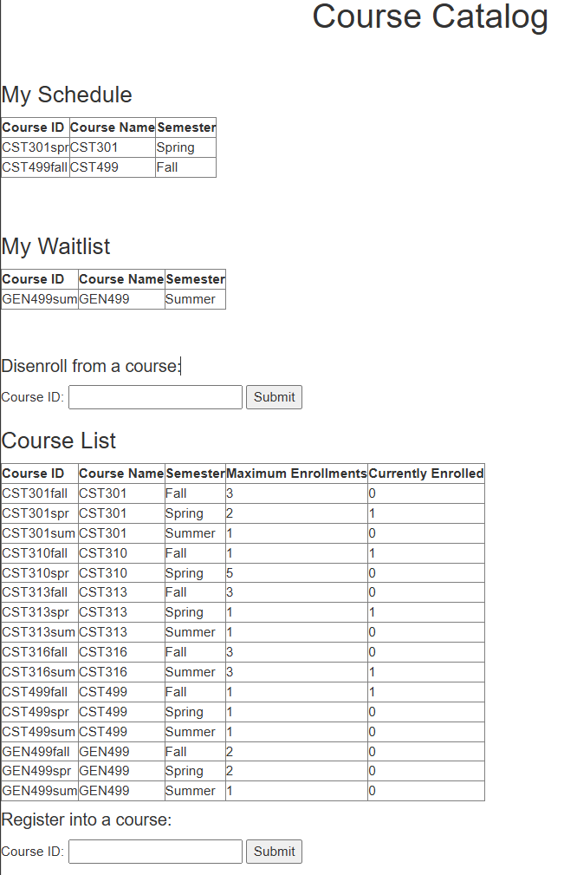
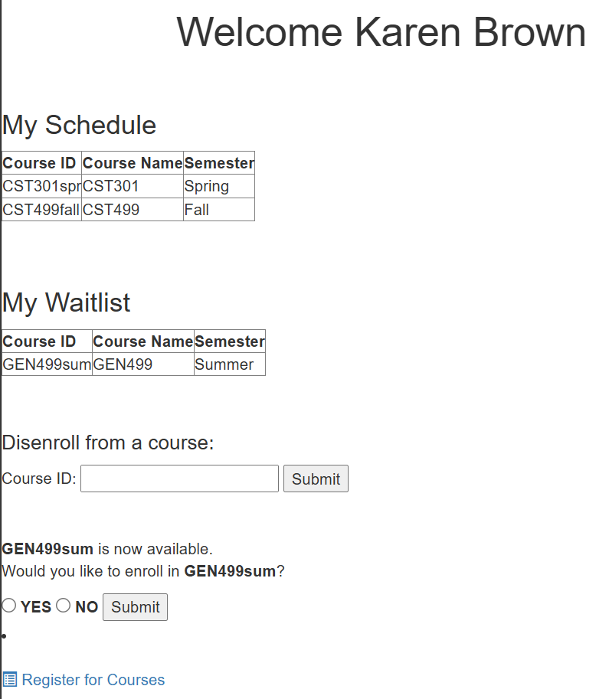
Class Registration & Enrollment Page
Notes:
The class registration functionality through the enrollment pages are displayed at the student’s homepage and the course catalog. Both will display the student’s currently enrolled and waitlisted courses they have. They both provide the delete functionality to remove themselves from either.
On the course catalog, it provides all the courses offered by the university displaying their capacity and how many students are currently enrolled. Here is where students will register for courses that will be added to either their schedule or waitlist.
On the student home page, this features the waitlist notification functionality that will let the first person on the waitlist know when someone has disenrolled from a course they are wanting to enroll in but was full at the time. When the student receives this notification, they can either add or delete that course from their schedule.

Slide 7
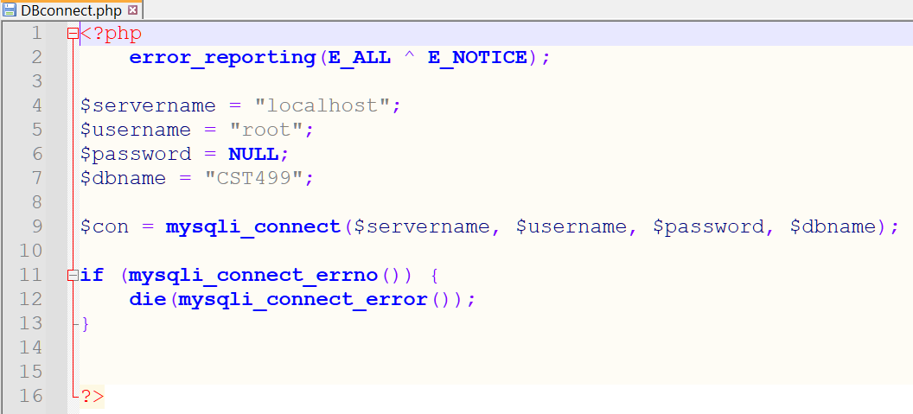
MySQL Database
Notes:
We utilize MySQL databases to store all the information necessary for this registration system. Connecting to the database is done through the MySQLi_connect rather than with MySQL_connect. “The “i” stands for improved, which was deprecated in 2012” (W3Schools, n.d.) indicating that this is the new more secured method. If there is an error with the connection, we stop it with the die() function.

Slide 8
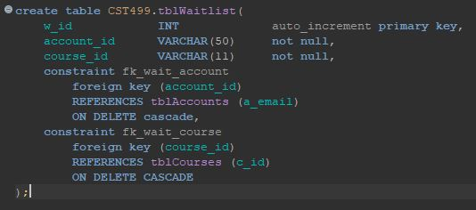
MySQL Database – Foreign Keys
Notes:
The databases created are for the student accounts, courses, enrollments, and waitlists. Depicted here is the waitlist table, which features foreign keys that create a relationship between this table and the student’s email from the accounts table and the course ID to the courses table. If a student withdraws from the university or a course will no longer be offered, any waitlist records that have either of these primary keys will be automatically deleted to prevent data from accumulating and affecting the system’s performance. This feature is also applied to the enrollments table with the same primary and foreign keys.

Slide 9
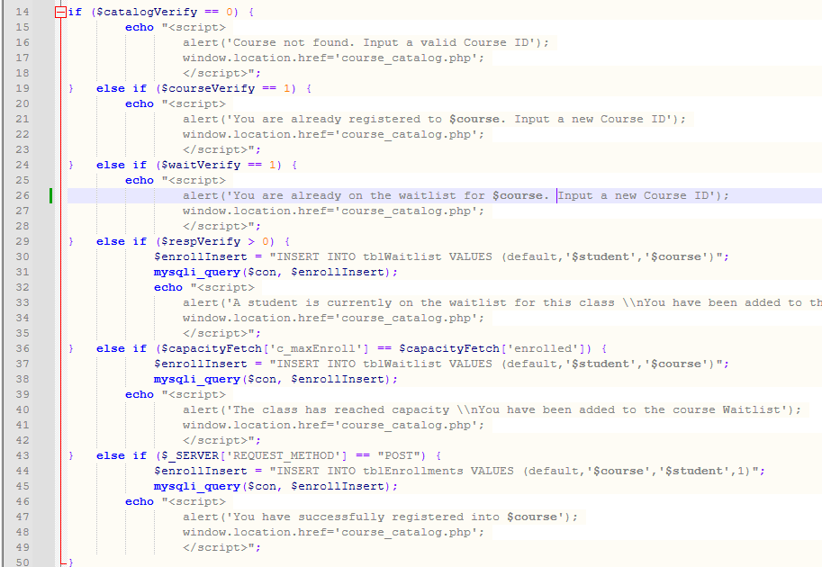
Personal Home Page (PHP) Code
IF…ELSE IF Statements
Notes:
The Personal Home Page (PHP) code is what we use to have our website interact with our databases. Throughout the system, we utilized IF…ELSE IF statements to perform the requirements outlined in the SRS. Displayed is the the add_course php file that goes through a series of IF statements to determine if the student can add the course they entered in. The possible outcomes for this component was explained in the activity model shown earlier today.

Slide 10
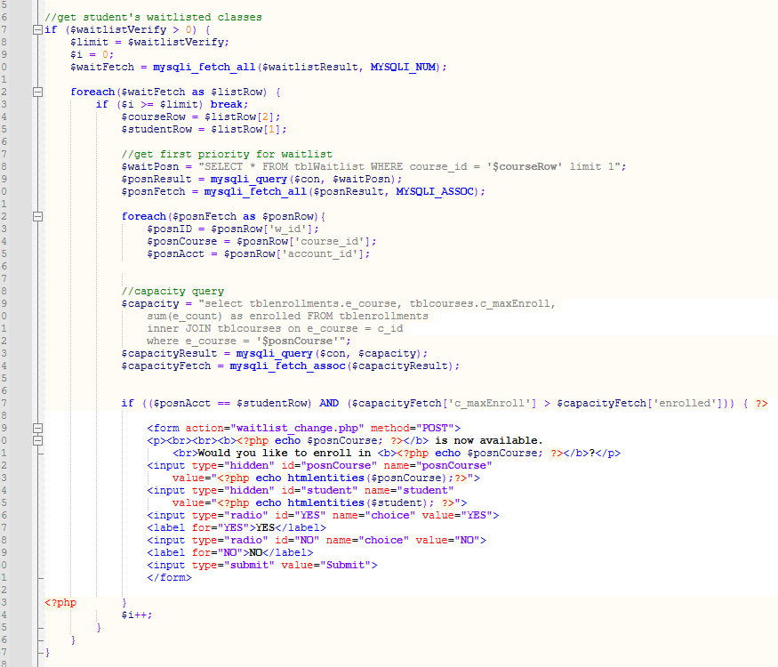
Personal Home Page (PHP) Code
IF Statement and
FOREACH() function
Notes:
Another important requirement for this system was creating the waitlist notification system, which is shown on the course_available php file. Through a series of FOREACH functions combined with IF statements, we check each course a student is waitlisted and next in line for, confirm there is not a vacancy in the course, and provide the option to the student to now add the available course or not. Two things that I want to point out are the $i variable and the limit 1 constraint. After each execution, $i will add 1 until it is equal to the number of waitlisted courses this student has. When it reaches this point, it will break and stop performing the FOREACH function. The limit 1 constraint is added to only query the waitlists that the student is the next in line for. Otherwise, it could result in fetching a very large amount of data that would only negatively affect performance.

Slide 11
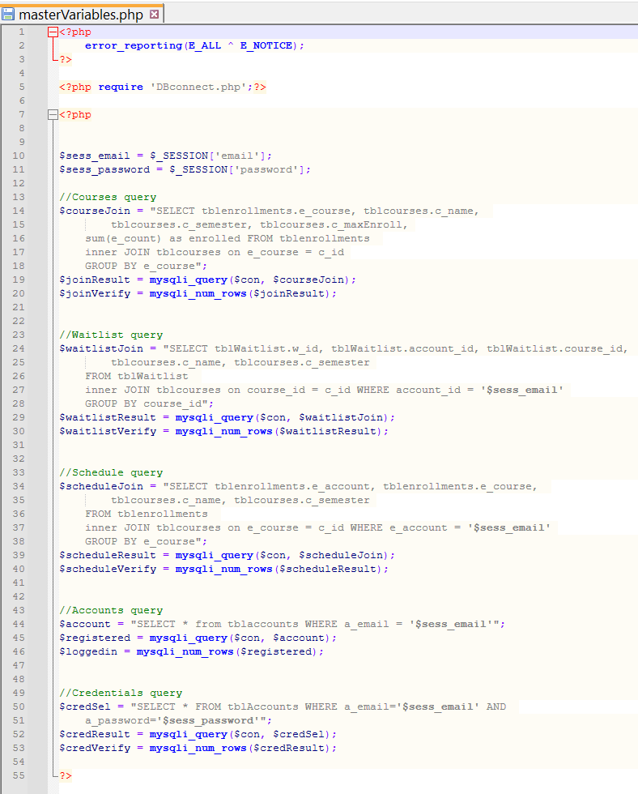
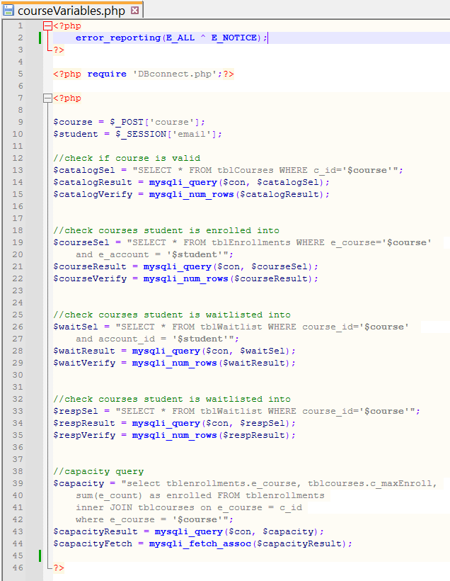
Personal Home Page (PHP) Code
Variables Files
Notes:
To promote modularity and reusability, common variables have been compiled into the masterVariables and courseVariables php files. The masterVariables file will contain queries where only the student's credentials are required. The courseVariables file will revolve around the logged in student’s account and their course ID input.
These files reference the same variables and perform the same queries, but their only difference are the table records they select. An example where this has been especially useful for are to display the schedule, waitlist, and course list that were shown earlier in this presentation. To obtain the variables and queries for these lists, their individual php files only need to reference this masterVariables file to perform these functions.
Another reason for this approach is that it keeps everything clean and prevents us from overcrowding the code. Imagine writing code that you fully copy into each php file individually. Then during testing, there is a fatal error that you need to now resolve. In this scenario, you must double check every single file to ensure that this fatal error is resolved completely. With our approach, you would only need to fix these variable files and the specific component to resolve the error. The goal here is to avoid creating files that are larger than necessary and make it easier to view for any personnel during tests and maintenance for this system.

Slide 12
References
GeeksforGeeks. (2024, January 2). Importance of Software Requirements Specification (SRS). GeeksforGeeks. https://www.geeksforgeeks.org/importance-of-software- requirements-specification-srs/
GeeksforGeeks. (2024, June 25). Unified Modeling Language (UML) diagrams. GeeksforGeeks. https://www.geeksforgeeks.org/unified-modeling-language-uml- introduction/#
W3Schools. (n.d.-b). PHP Connect to MySQL.
https://www.w3schools.com/php/php_mysql_connect.asp
Notes:
With the points that were outlined in this presentation, we have successfully created the course registration component that can be later integrated to the larger university system.

